Slide 1

The Battle of Neighbourhood
Jane Barrio

Slide 2
Content
Introduction
Data collection
Methodology
Results
Discussion
Conclusion

Slide 3
Introduction:Business Problem
Figure out the safest borough based on Toronto Crime Rate for the inauguration of a new restaurant.
Discover the optimal common venues and select the appropriate neighbourhood within the borough to establish the new restaurant.

Slide 4
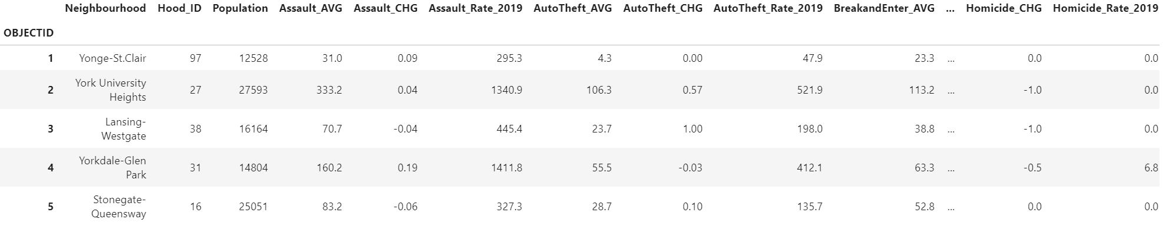
Data collection
Toronto Crime rate (https://www.kaggle.com/alincijov/toronto-crime-rate-per-neighbourhood)
Venue Data in every neighbourhood will be obtained using Foursquare API
Geocoder Package are used to provide Geographical Location data (https://cocl.us/Geospatial_data)

Slide 5
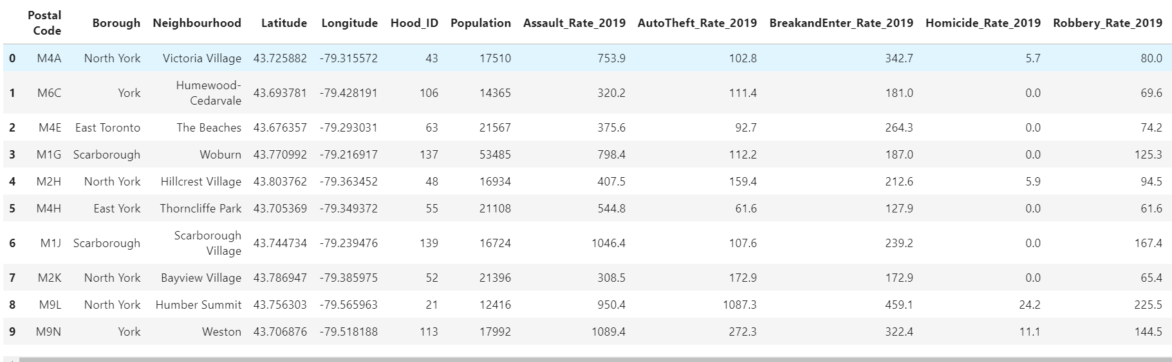
Methodology
Data Cleaning and emerging of 3 dataset listed above to get the figure below with the crime rate in 2019 in Toronto

Slide 6
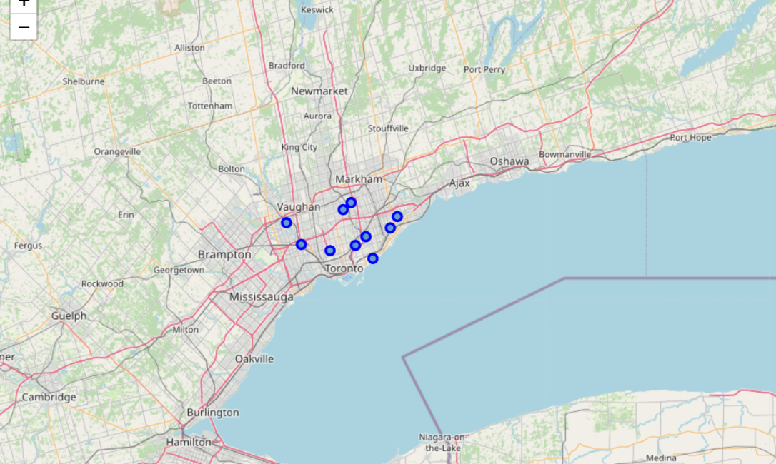
Methodology: Exploratory Data Analysis
Python provides useful libraries such as Folium which gives us the ability to obtain an interactive map using geographical coordinates data together with the Toronto Crime Rate.

Slide 7
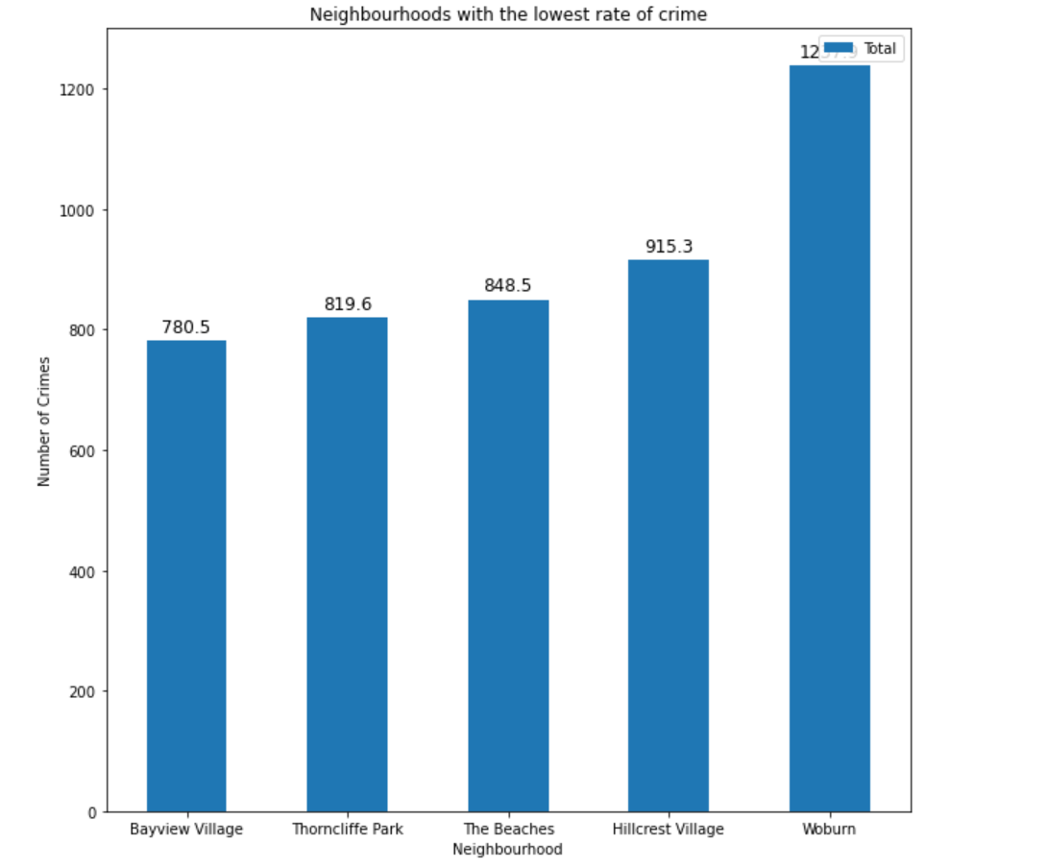
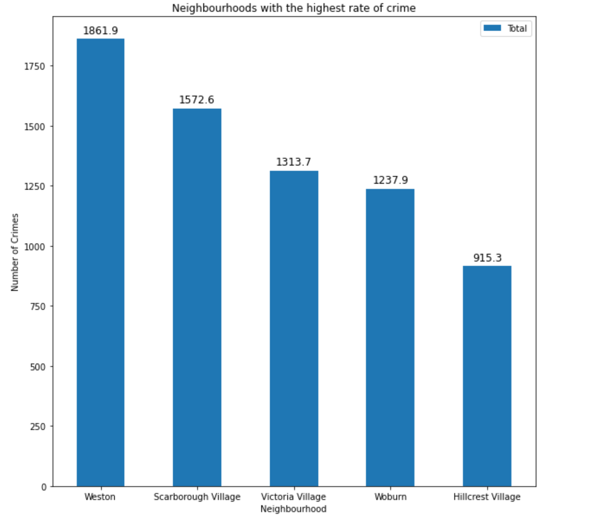
Borough with the highest and lowest crime rate in Toronto

Slide 8
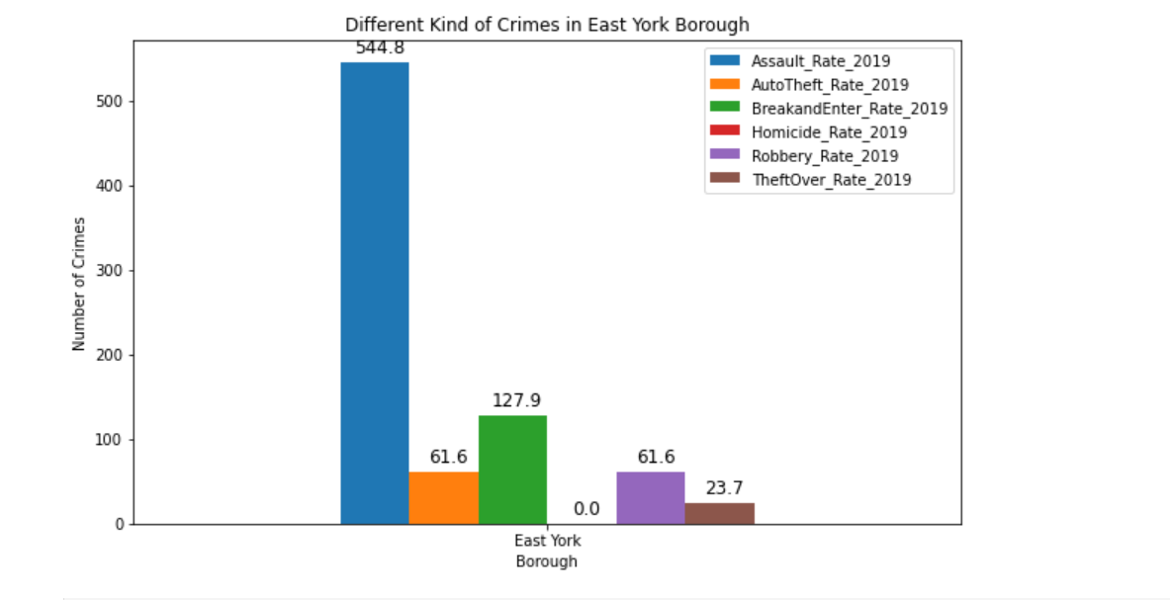
Lowest Crime rate location: East York Borough

Slide 9
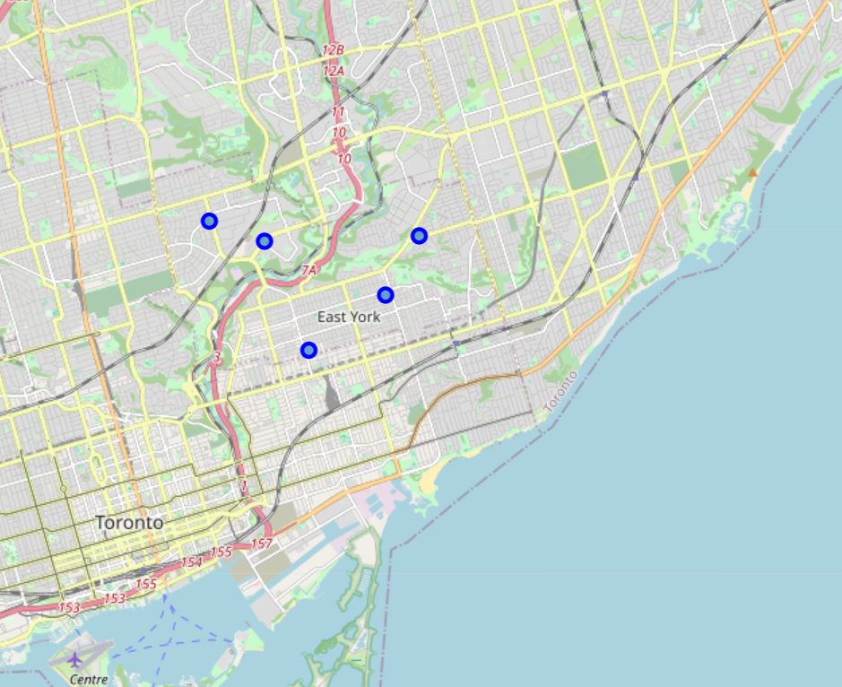
An interactive map of the East York borough

Slide 10
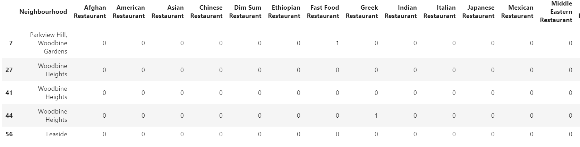
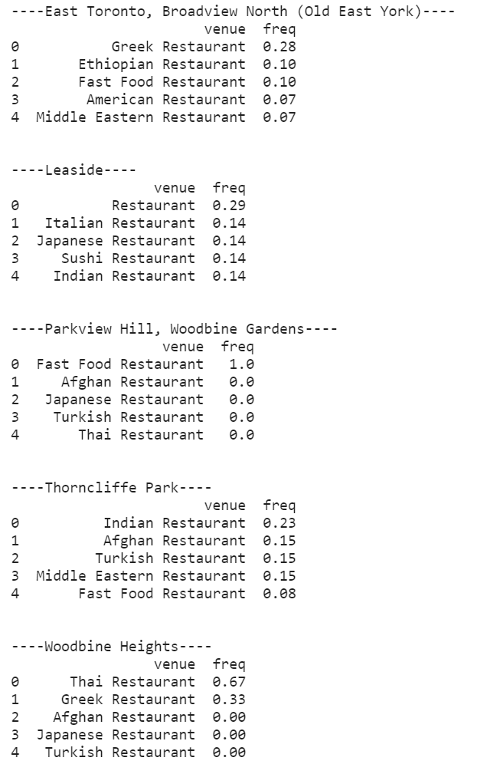
Machine Learning
The realisation of the analysis of the collected data is carried out by performing the one hot encoding technique which is used to convert categorical data into numerical one. The East York borough have numerous neighbourhood which can be analysed individually. Therefore, for each neighbourhood, we recorded the frequency of each venue in the aim to determine which venue has the more client density.

Slide 11
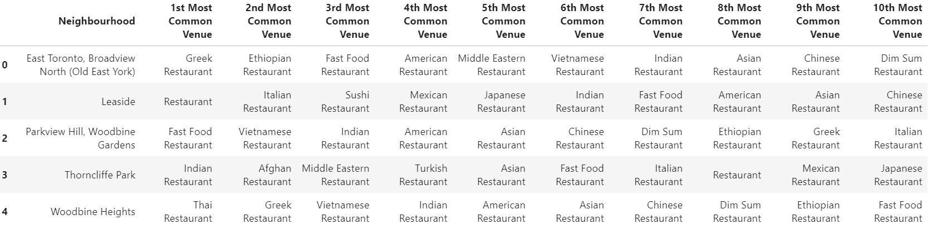
Extraction of the neighbourhood with its 10th most common venues.

Slide 12
K-Means Clustering of the neighbourhoods

Slide 13
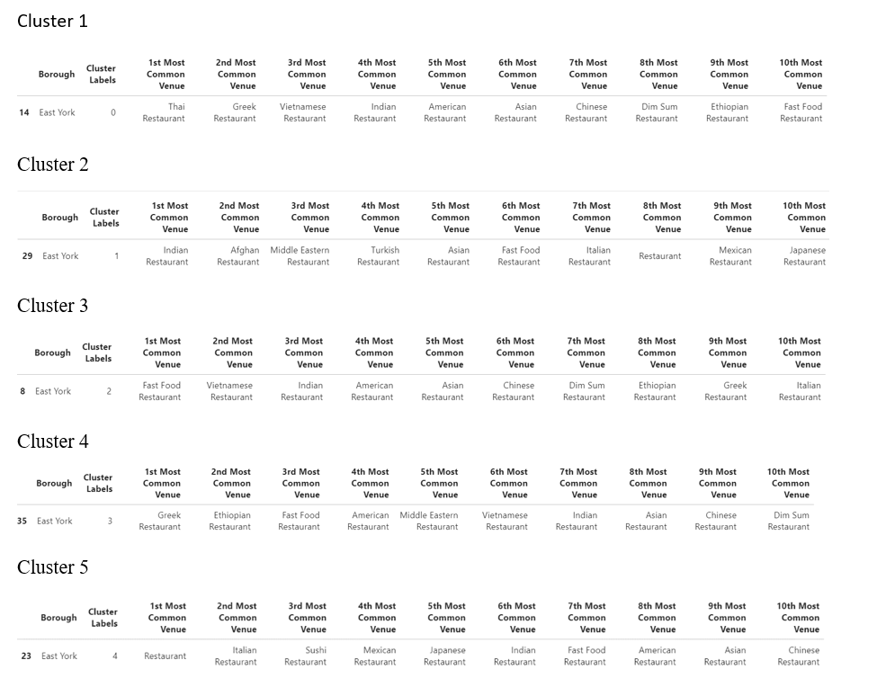
Examination of the 5 different clusters in the East York Borough

Slide 14
Results
From the 5 clusters obtained above we can figure out that:
The Toronto Crime Rate dataset has provided the opportunity to identify the borough with the lowest crime rate in order to establish a new restaurant.
The East York borough has a variety of different restaurant available to the Toronto’s population.
For businessmen who are invested in Thai restaurant, according to our data, cluster 1 is the only cluster where the East York’s population has a Thai restaurant.
Cluster 1 and Cluster 5 are the clusters which have the tendency to have many Asian restaurants.
Cluster 4 is an optimal place for the opening of a Mexican restaurant.

Slide 15
Discussion and Conclusion
East York borough is the optimal location for the establishment of a new restaurant.
All clusters except the cluster 1 are considered to be a potential place for the inauguration of a Thai Restaurant.
Cluster 4 is the only cluster which does not possess a Mexican restaurant. Investors can use this information to have decision making about the opening of a Mexican restaurant.
Throughout this project, we have been able to identify the different boroughs with their corresponding neighbourhoods which have the highest crime rate as well as the lowest crime rate in 2019.
Thus, we identify the potential borough with the lowest crime rate to see the different types of restaurant which are already there. The objective is also to find a safe place for a new restaurant but also an area where there is not many restaurants.
As a results, stakeholders can use these important information to make a strategic approach and to decide which type of restaurant to inaugurate.
However, some drawbacks have been detected and this shows that we could use more datasets about the population density, age and religion in order to have a more precise idea about which type of restaurant we can inaugurate in the neighbourhood.
This project can also be used to detect and solve any real life scenario such as the opening of a new grocery store in the region.

